Slide 1
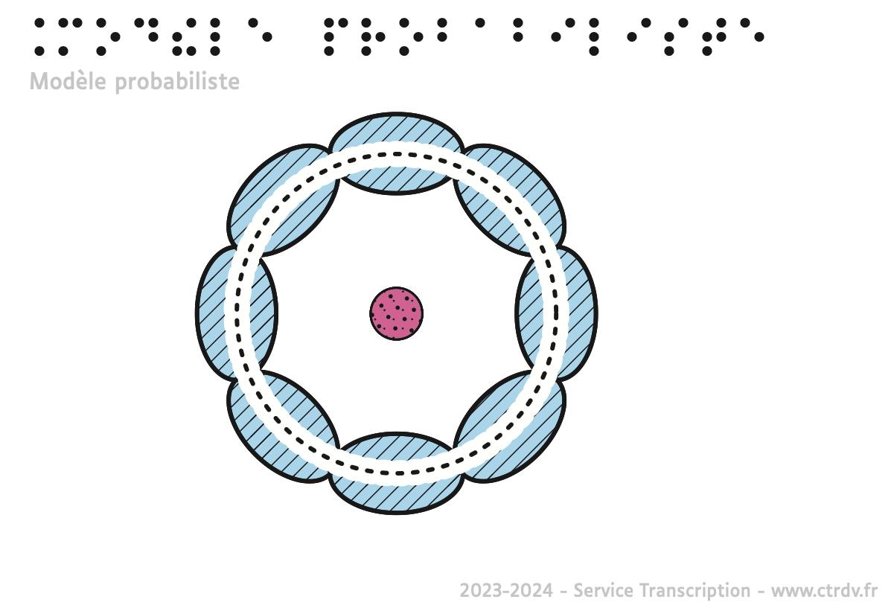

Tactile graphics in France
Association des
Transcripteurs
Adaptateurs
Francophones

Slide 2
Production units for tactile graphs
Different types of production units
Medical and social care services (dedicated dept)
Associations or accessible format publishers (dedicated dept)
Public units
Freelance individuals
Funding
Ministry of health (until A Level)
Universities (beyond A Level)
Orders from public services (museums, libraries…)
Orders from private companies from their own budget
Grants for associations
Individuals (through public aids)
Notes:
Mainly academic
No statistics on production recipients
Mosaic of units due to 1975, 2005, 2013 laws so the heterogeneity

Slide 3
Tactile graphics designers
No official statistics ~200-250 adaptors
Missions
Adaptors in the school environment: text + tactile images
Adaptors in other environment: one or both
Training
Current training (certification): adaptors can do both
Internal practices and self learning to complete their training
Notes:
School environment is more homogeneous

Slide 4
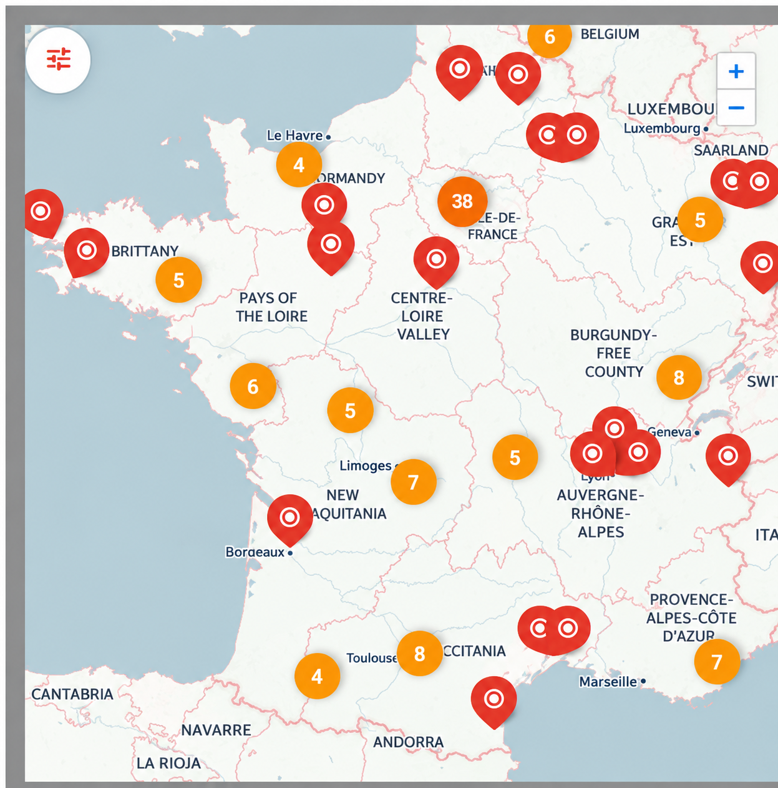
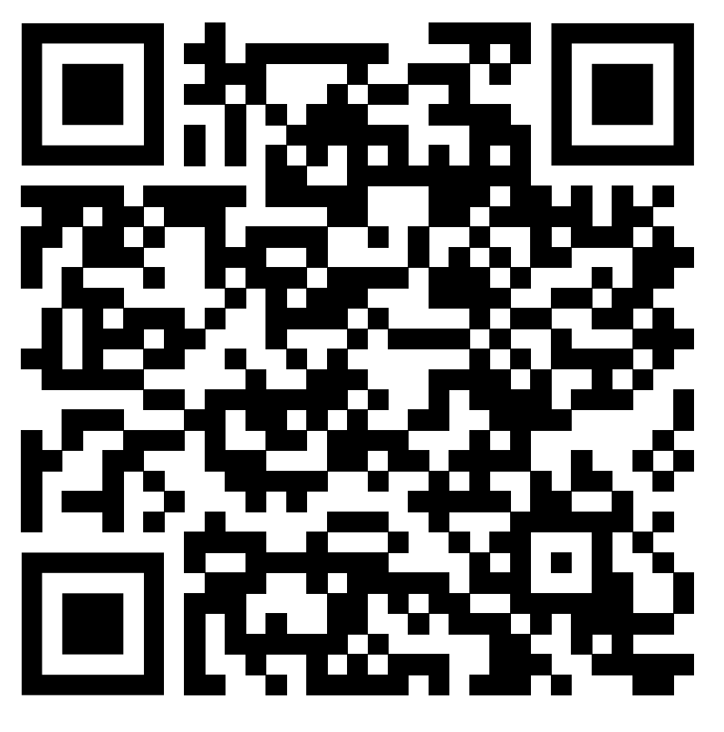
Cooperation between production units
Databases
Platon, BDEA (books)
Image banks :
CTRDV https://mallette.ctrdv.fr/opac_css/
INJA https://injalouisbraille.fr/BDEAINJA/
INSEI https://www.insei.fr/ressources/banque-dimages-du-sdadv
Cooperation strategies
No formalised cooperation
Informal exchanges
ATAF : documenting professional practices and representing the profession
Notes:
PLATON (Platform for the Transfer of Digital Works) is a database and secure platform managed by the Bibliothèque nationale de France (BnF).
Role: It acts as an intermediary between book publishers and authorised organisations.
Objective: To facilitate access to reading for people with disabilities by enabling the digital adaptation of works (Braille, Daisy audio format, large print) within the legal framework of the ‘disability exception’ to copyright law.
ATAF (Association des Transcripteurs Adaptateurs Francophones) brings together professionals involved in transcription, adaptation and accessible formats. Its role is to foster exchanges between practitioners, document professional practices and developments, support training and quality initiatives, and represent the profession in discussions with institutions and stakeholders.

Slide 5
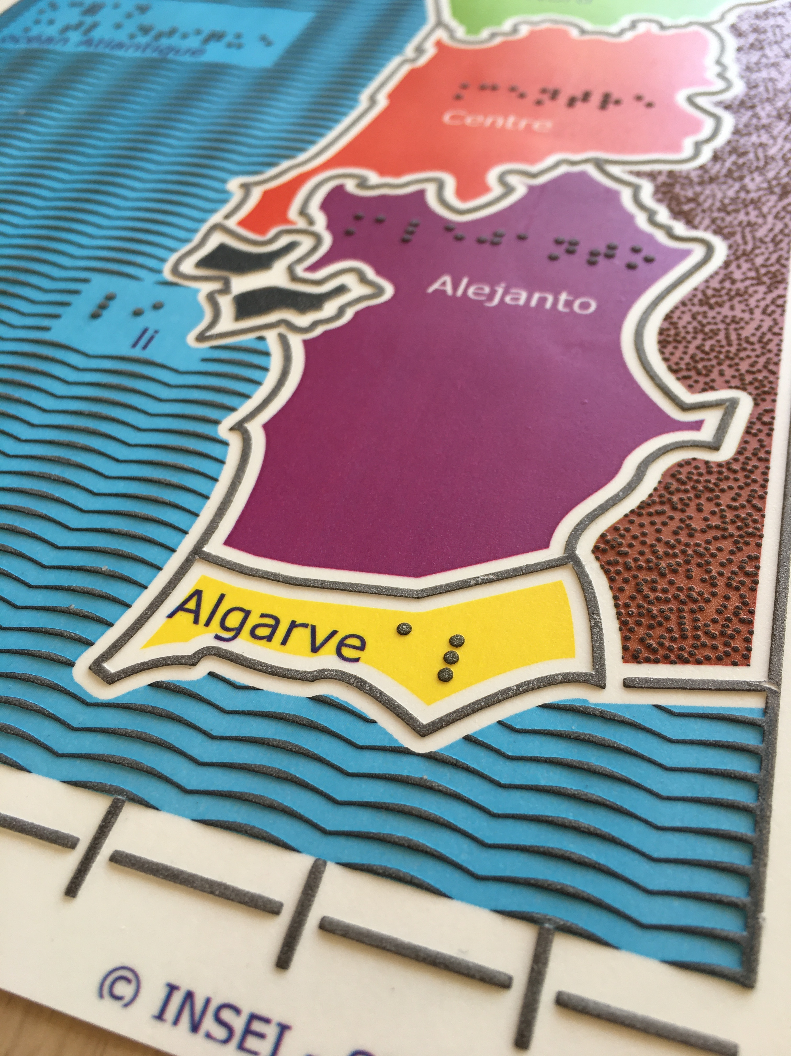
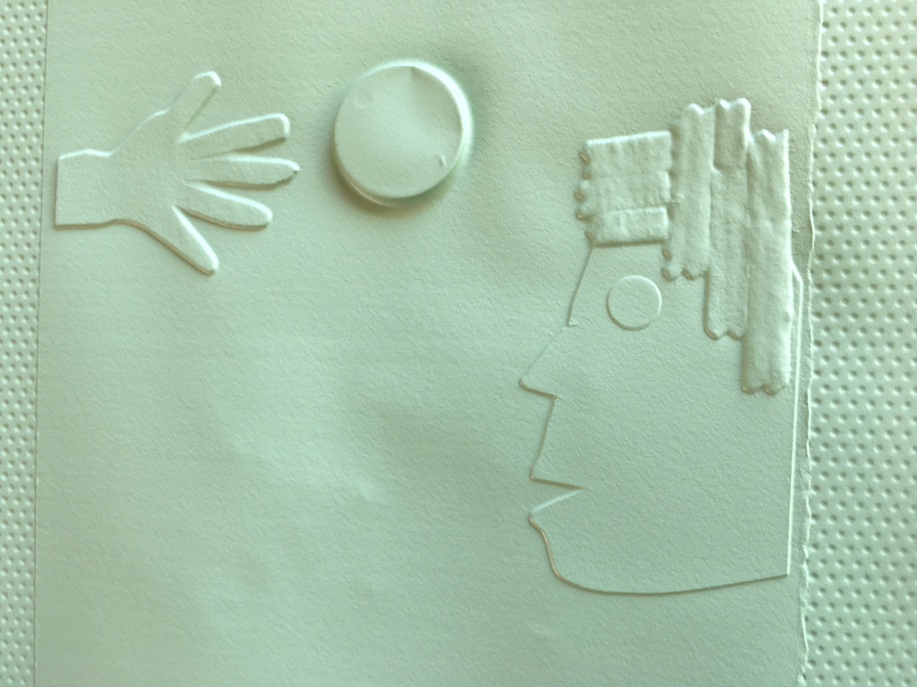
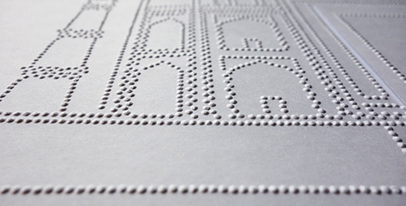
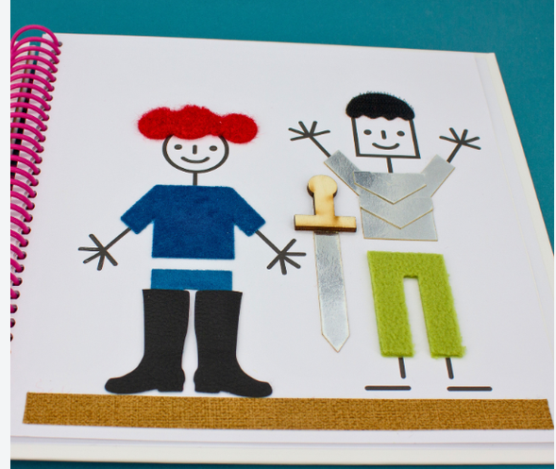
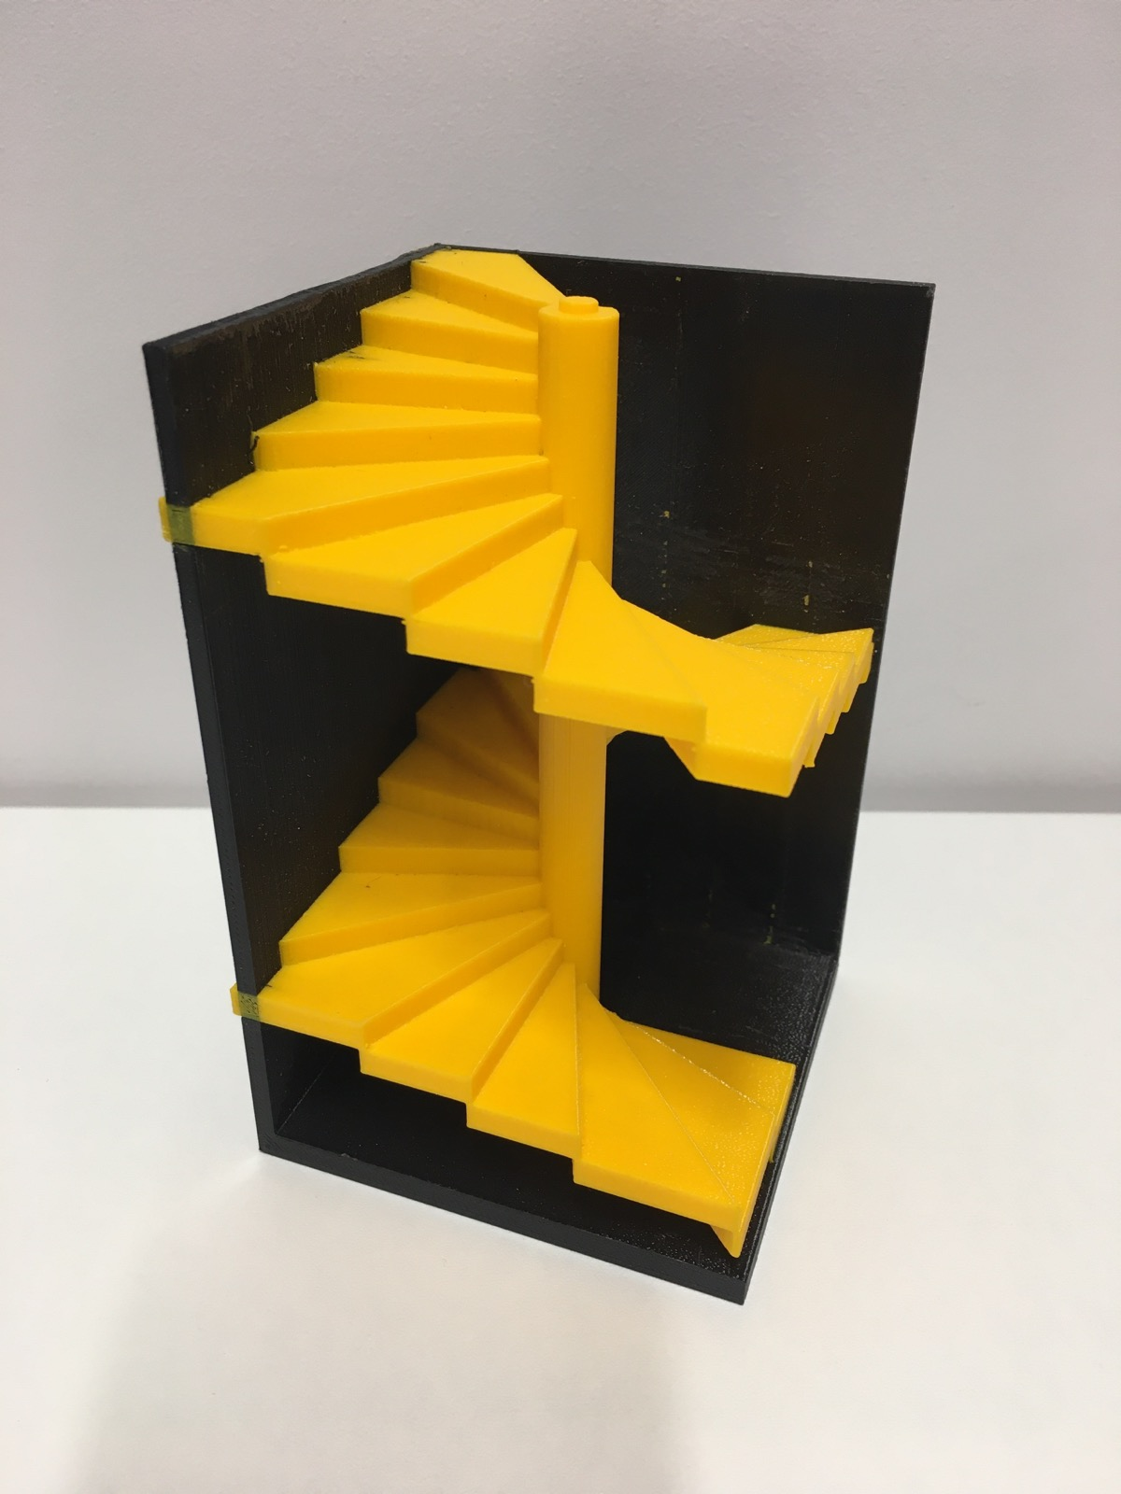
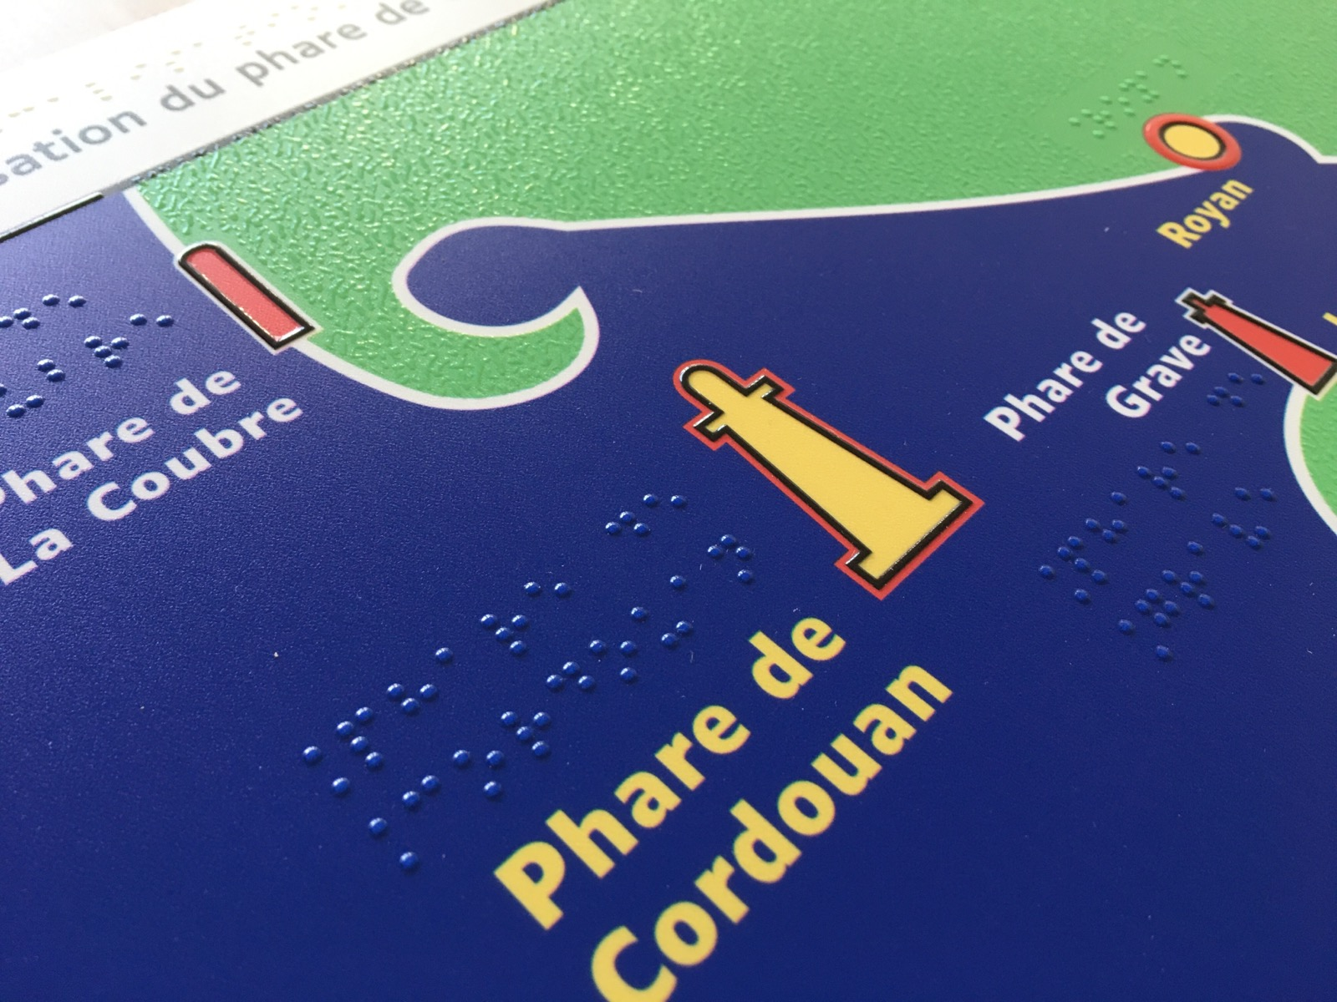
Used techniques
Thermorelief / swell
Thermoforming
Embossing
Tactile collage
3D printing
Resin-based 3D

Slide 6
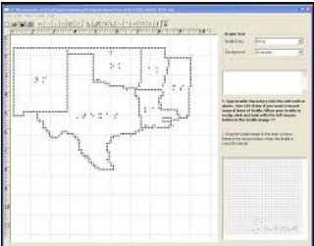
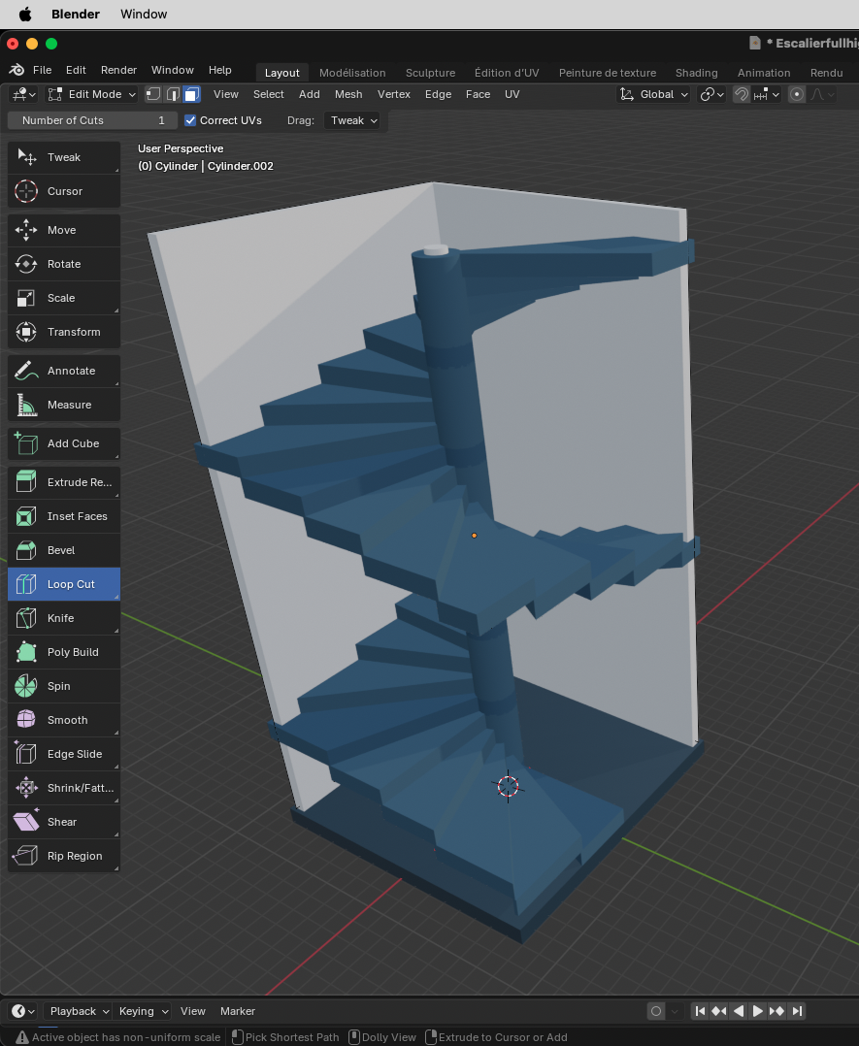
Softwares (examples)
Vectorial graphics software
  Inskcape
  Illustrator
  CorelDraw
Printer (standard braille/3D) management software
  Quicktac, DBT (Duxbury), EtexteB, TactileView
  3D modeling softwares
Others
  Word
  Powerpoint
Notes:
Cécile : Préciser ici que ce sont des exemples parmi d’autres, que chaque centre choisit les logiciels utilisés

Slide 7
Life cycle of a graph
Graphs are produced for the first time (original)
Ready-made graphs are proposed by the transcriber to the teacher
Reuse of an old graph (collected, kept and archived by the teacher)
Why reusing a tactile graph ?
Financial reasons
Immediate availability
Notes:
It mainly depends on the teacher’s methods

Slide 8
Requesters
Requesters
Schools (through special need teacher mainly)
Individuals
Museums
Public services
Notes:
Difference in funding : staff / equipment

Slide 9
Support in reading tactile images
School environment
Subject teacher
Special need teachers
Helpers for student with a disability
Occupational therapist
Other environments
Parents
Professional assistants (freelance)
Mediators in cultural venues
Notes:
Difference in funding : staff / equipment

Slide 10
Decision in adapting an image
School environment
Student’s need: transmission by the mainstream teacher / special need teacher to the transcriber
> the relevance of the adaptation is discussed
Standard environment
Public request: work between transcriber and the customer (expertise and consultancy)

Slide 11
What the tactile images/3D objects are made for ?
Customised
On request
For one reader or a group of readers
Subjects
School topics
Museums
Public services
Communication (posters)
Notes:
There is no extra work when an image is produced for a group (the original design matters)
Subject: depends on the requesters

Slide 12
Feedback on using a tactile image
Depends on the requester
Depends on the location of transcription department (medical and social care services / mainstream school / department for the inclusion of the student with a disability)
> Not enough feedback from the field
Notes:
There is no extra work when an image is produced for a group (the original design matters)
Subject: depends on the requesters
School: no test in the design phase
Others : tests and prototypes during the design phase
Not enough feedback in both case after delivery

Slide 13
Guidelines
In 2003, guidelines have been published by the INSEI and is widely used in France (no obligation).
No formal agreement on guidelines between production units
Mutual use of databases (assimilation)
Since 2025, an ATAF working group has been developing a common guide, combining established international guidelines with practical expertise gained from the field by French professionals.
Notes:
Each service is coherent with their own guidelines

Slide 14
Strengths and weaknesses in the French system
Strengths
Many departments
Important production
Existing training for image adaptation
Existing guidelines
Rich databases and image banks
Weaknesses
But unevenly distributed across the country
But some departments do not make their output available
But not efficient enough and all adaptors are not trained
But not adopted by everyone
But not pooled

Slide 15
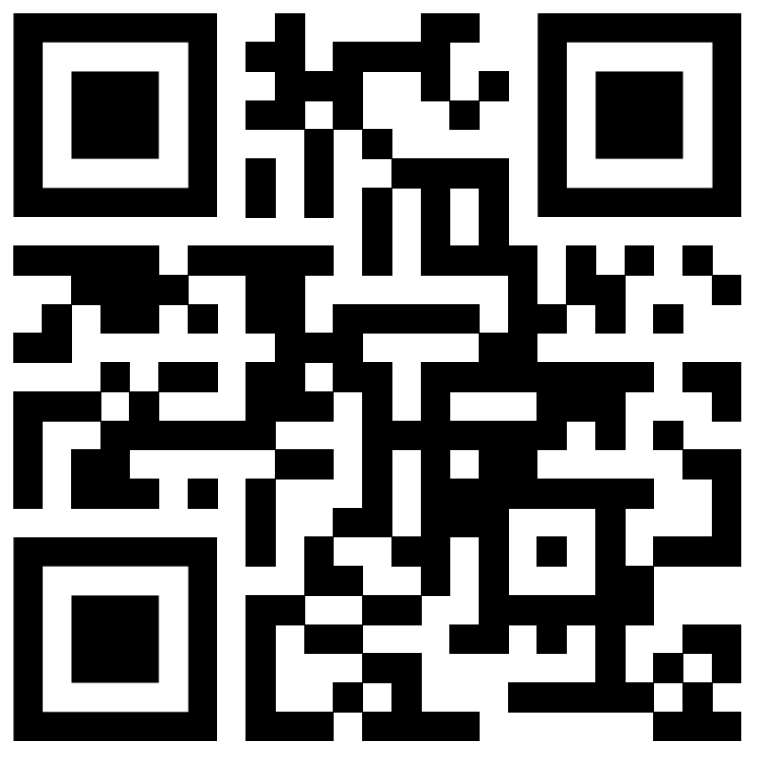
Thank you for your attention
https://transcripteur.fr
Association des Transcripteurs Adaptateurs Francophones
contact@transcripteur.fr

