Slide 1


INTERNATIONAL ONLINE MEETING
Tactile Graphics Production in Europe
Contexts, Techniques and Uses
24th September 2026
• Poland (Emilia Smiechowska-Petrovskij) & France (Mathieu Gaborit)
Notes:
Hello everyone, and welcome to this first international online meeting on tactile graphics production in Europe.
First of all, thank you very much for being here today.
We are very happy to see participants from 13 countries !
My name is Cécile Barichard and I am a member of ATAF, the French speakers association of transcribers.
Today, we will hear two presentations: the first one from Poland, presented by Emilia Smiechowska-Petrovskij, and the second one from France, presented by Mathieu Gaborit.

Slide 2
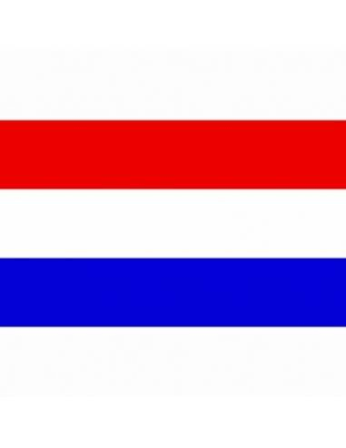

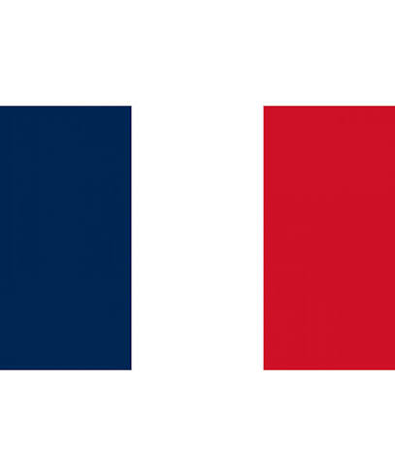

How did this initiative begin?
Creation of a small international working group
First meeting (online) December 2025
January to June 2026: definition of the objectives
July 2026 – September 2026 : preparation of the First international meeting
Notes:
First of all, I’d like to briefly explain how this project started.
The idea started after the Tactile Reading Conference in Amsterdam in 2025.
During the conference, professionals from different countries talked about tactile graphics production.
We realised that our organisations and our ways of working are different, but we also have many questions and challenges in common.
So, we thought it would be useful to continue these discussions after the conference.
We created a small international working group and decided to organise regular online meetings.
The members of the group are from the Netherlands, Poland, Sweden and France.
ATAF organises these meetings, but we all work together as a group.
And I take the opportunity today to thank all the members of the group for their participation.

Slide 3
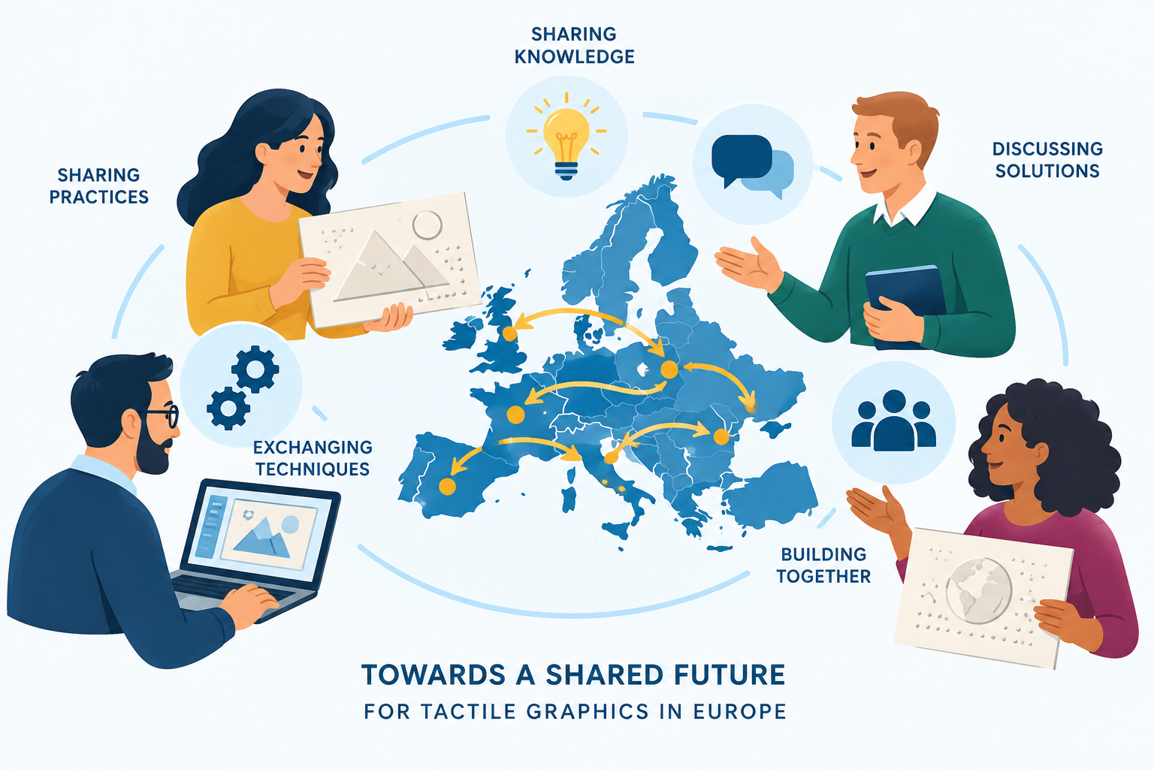
Our objectives
Building an international network for tactile graphics
Get to know each other
Understand different national contexts
Share practices and experience
Discover methods, tools and technologies
Better understand users’ needs
Identify opportunities for collaboration
Notes:
Our first objective is very simple: to get to know each other.
We want to understand how tactile graphics are produced in different countries.
Who produces them? What techniques do you use? And what do users need?
We also want to share our practices and experiences.
And in the future, we hope these discussions can lead to new collaborations between countries and organisations.

Slide 4
The first meetings
3 online meetings (24th September 2026, 19th November 206, 14th January 2027)
2 countries / meeting
Today: Poland & France
After these first three meetings, we will assess the format together and decide how to continue and expand the project.
Notes:
For the moment, we have planned three online meetings.
The next meetings are planned for the 19th of November and the 14th of January.
At each meeting, two countries will present their situation and their practices.
Today, we will discover Poland and France.

Slide 5
Before we start...
Zoom name: First name SURNAME – Role – Country – Organisation (eventually)
Recording: for report-writing purposes only; it will not be shared or published.
Thank you for being here! Let’s start with Poland.
Notes:
Just a few practical points before we begin.
First, it would be very helpful if you could identify yourself clearly in Zoom.
If possible, please indicate your first name, surname, role, country, and organisation.
This will help everyone to know who is speaking, and it will also help us when we prepare the meeting report.
The meeting will be in English. But English is not everyone's first language – and certainly not mine!
So please don't hesitate to speak slowly, to ask someone to repeat something, or to say if you don't understand.
The important thing today is to communicate and exchange ideas.
Let’s start with Poland with Emilia’s presentation. Emilia, I’m going to stop sharing my screen now. You can share your presentation. / Arrêter le partage d’écran

Slide 6
Meeting report
A public report will be prepared and shared
Published on the ATAF website https://transcripteur.fr/
Shared with participants and professional networks
Partners will also be able to share it
Recording: used only to help prepare the report
The recording will not be published or shared with third parties
Notes:
Thank you very much Emila and Mathieu for these presentations.
We would like to prepare a public report presenting the main information and ideas from the different countries.
This report will be published on the ATAF website and shared with participants and professional networks.
Our partners will also be free to share it through their own networks.

Slide 7
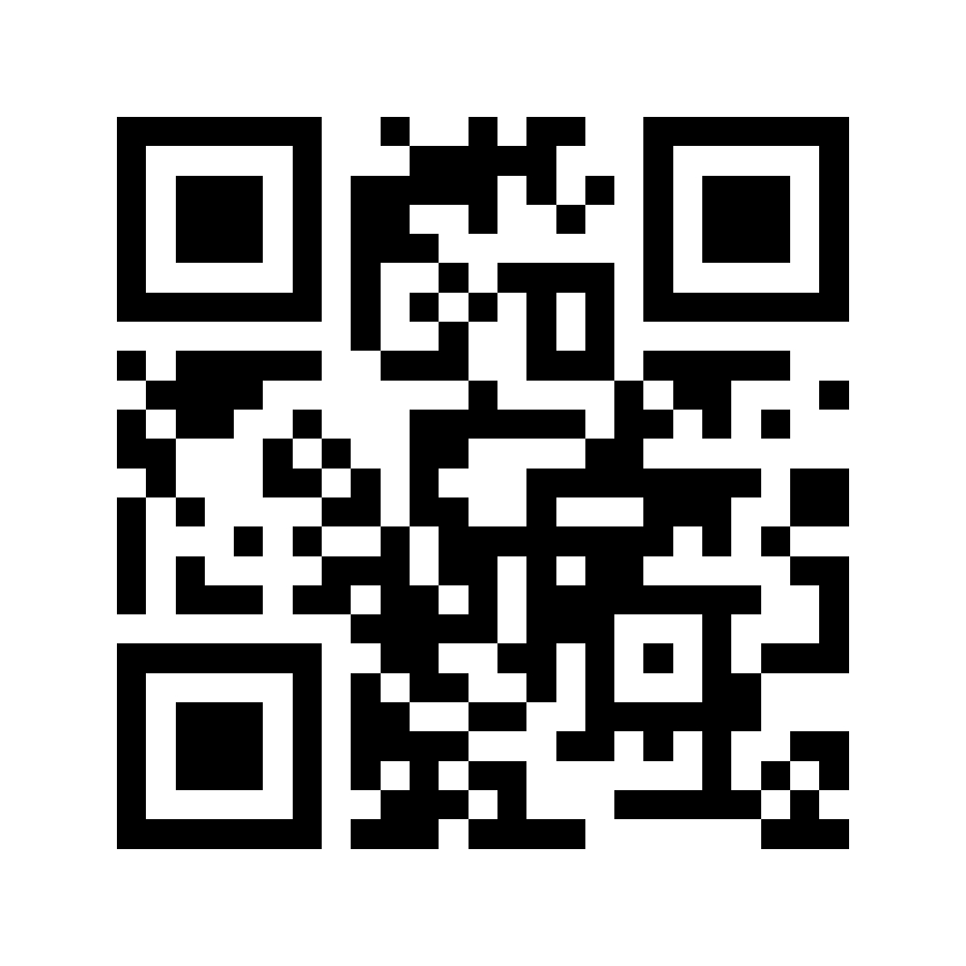
Let’s build the network together!
We would like this initiative to grow
Share your experiences • practices • tools • contacts • ideas
Interested in presenting your country?
Do you know other tactile graphics professionals ? From other countries
Would you like to join the organising group?
contact@transcripteur.fr
Notes:
And finally, this project can only grow if we build the network together.
If you know professionals working with tactile graphics in other countries, please tell them about this initiative.
If you would like to present how tactile graphics are produced in your own country, we would be very happy to hear from you.
And if you are interested in joining the organising group, you are also very welcome.
You can share your experiences, your practices, your tools, your contacts and your ideas.
You can contact us at contact@transcripteur.fr.
This brings us to the end of our meeting.

Slide 8

Notes:
Once again, a big thank you to Emilia and Mathieu for their presentations.
I would also like to thank Dorine, Sabrina and Théo, and all the members of our working group. And I’m sorry if I’ve forgotten anyone!
And of course, a big thank you to all of you for being here today and taking part in this first meeting.
Please feel free to send us your feedback. It will be very useful for our next meetings.
Thank you again, and have a great day, everyone!

