Slide 1
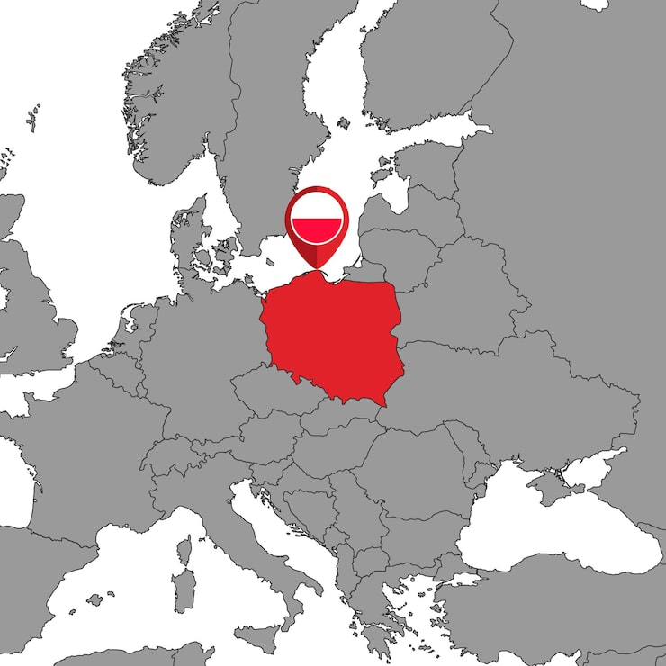


Tactile Graphics Production in Europe: Context, Techniques and Uses
Poland
Emilia Śmiechowska-Petrovskij
Cardinal Stefan Wyszynski University in Warsaw

Slide 2
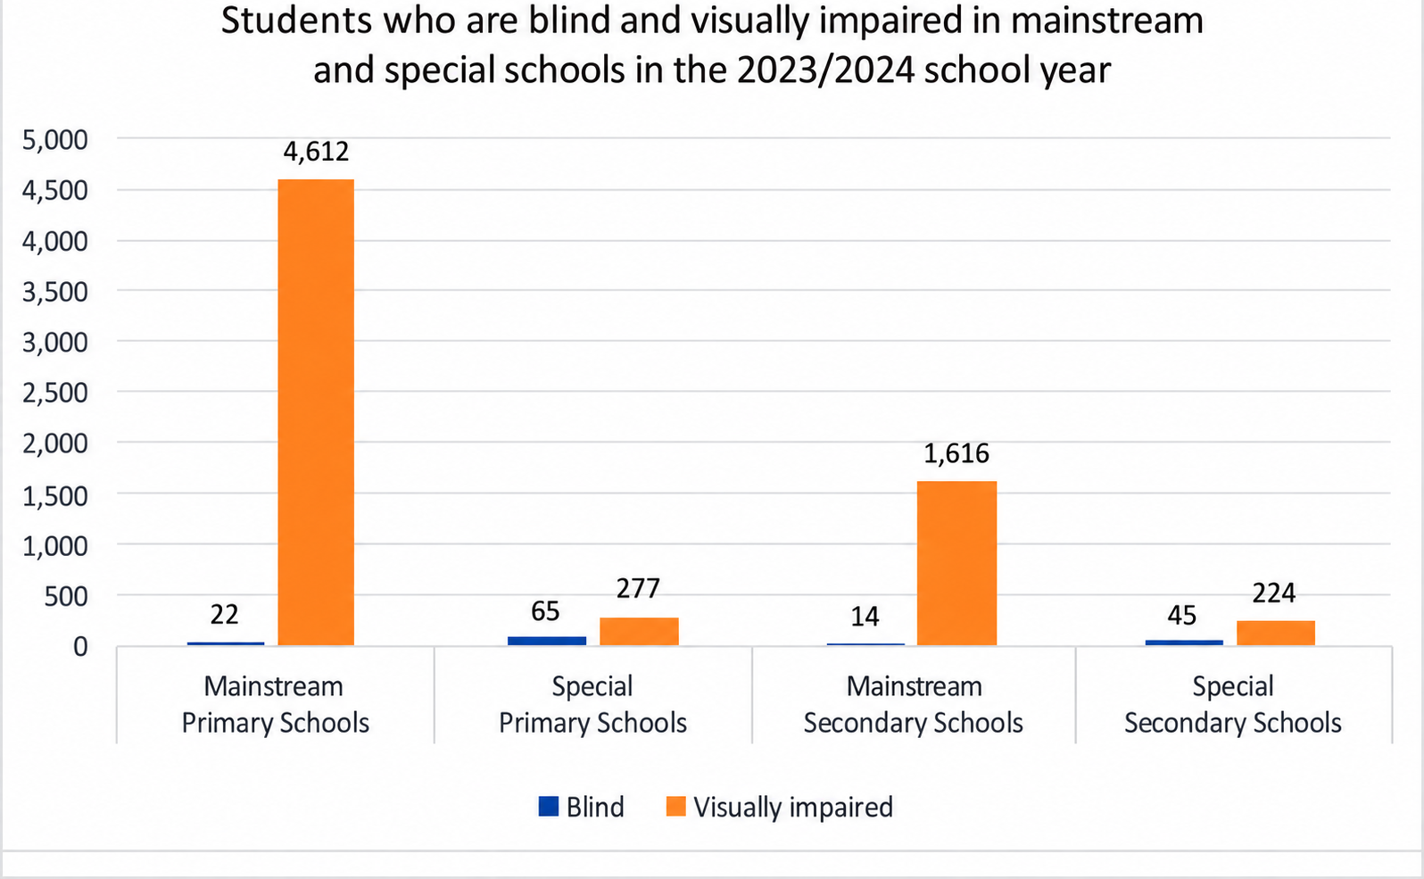
Education system for blind and visually impaired students in Poland
Education of students with blindness – mainly in special schools
Education of students with visual impairment – mainly in mainstream schools

Slide 3
Education system for blind and visually impaired students in Poland
Special educational centres for students with blindness (8 in Poland). They usually prepare tactile graphics and other adapted materials on their own. They also have specialised equipment (PIAF machines, 3D printers Index Everest Braille embossers) and their own collections of materials and models.
In mainstream schools (inclusive education), tactile graphics education is generally less developed. Schools often lack specialist teachers and appropriate equipment. At the moment, some special educational centres are also taking on a new role as Specialist Centres Supporting Inclusive Education, or SCWEWs.

Slide 4
There are several centres that prepare tactile graphics and other adapted materials independently (1)
The Ministry of National Education commissions the Centre for Education Development to prepare school textbooks in Braille and large print. The textbooks also include tactile graphics, mainly produced using Tiger embossers. For a short period, some graphics were also produced using termogprahy non-commercial, for educational purposes
The Polish Association of the Blind has a collection of more than 300 educational tactile graphics, which can be printed using a Tiger embosser or on swell paper commercial
University centres, for example the Centre for the Adaptation of Educational Materials at the University of Warsaw , John Paul II Catholic University of Lublin by the Centre for the Activation of Persons with Disabilities, including its Section for the Adaptation of Educational Materials for Blind Students: develops adapted teaching materials and makes extensive use of 3D printing and UV printing non-commercial for their own students, but commercial services are also provided

Slide 5
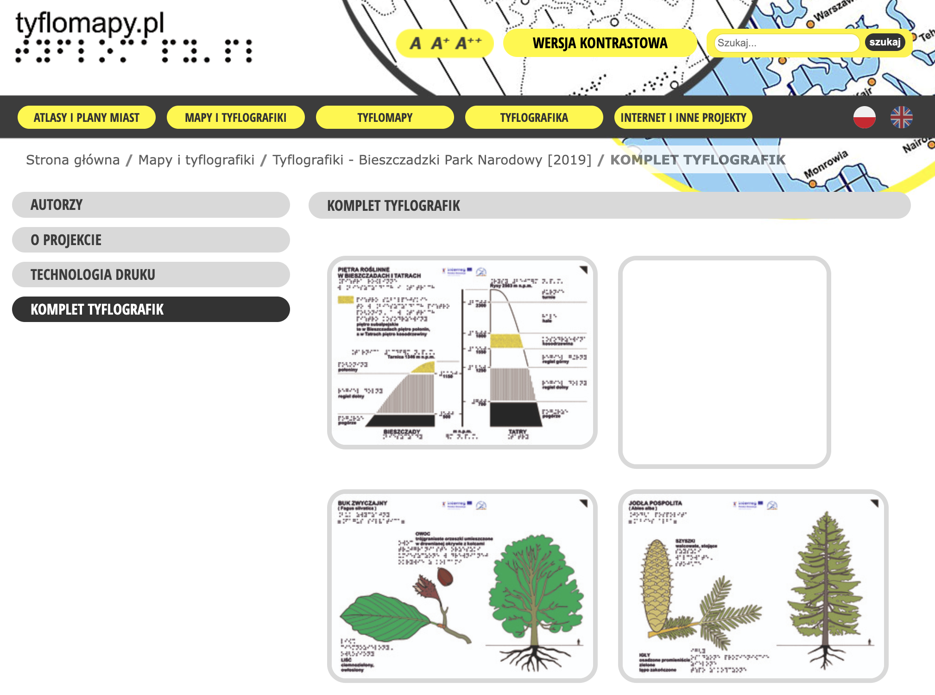
There are several centres that prepare tactile graphics and other adapted materials independently (2)
The Tyflomapy portal non-commercial access to database
https://tyflomapy.pl/Kilka_slow.html
Non-governmental organisations, for example Prowadnica commercial
On-demand production by private companies – several companies have more than ten years of experience, and since 2019 the number of providers has increased considerably (new law – Polish Accesibility Acts) commercial

Slide 6
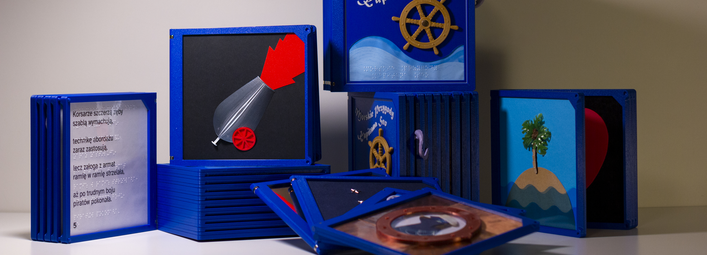
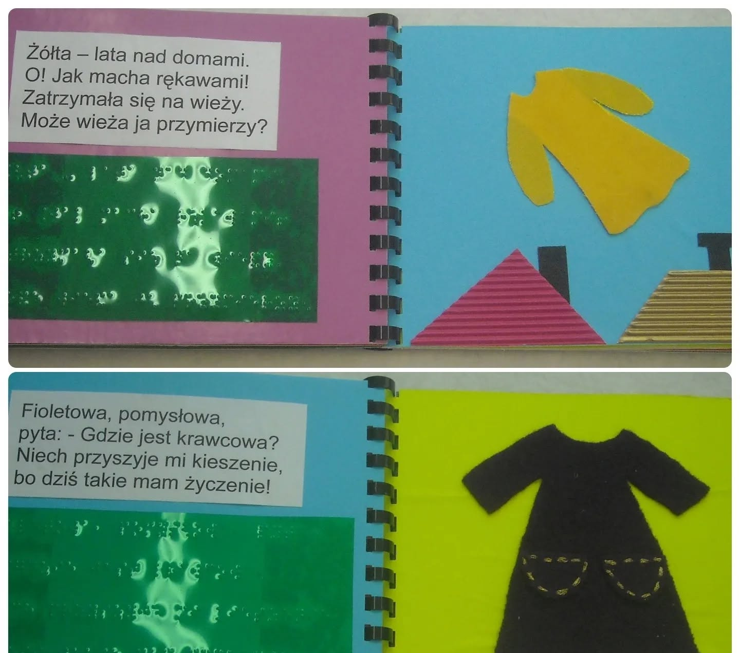
There are several centres that prepare tactile graphics and other adapted materials independently (3)
Bottom-up initiatives:
National tactile book lending library run by the Jasne Strony Foundation in Lublin
The Kołobajki Foundation in Łódź

Slide 7
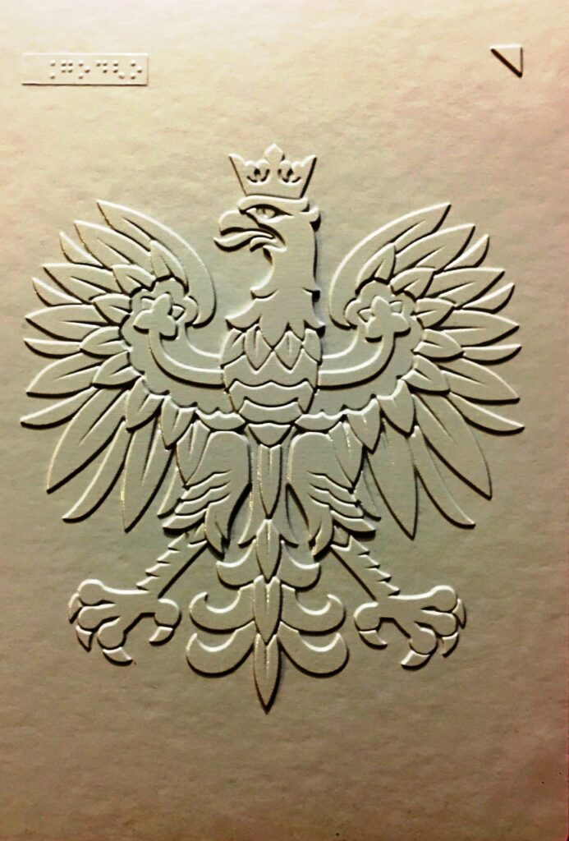
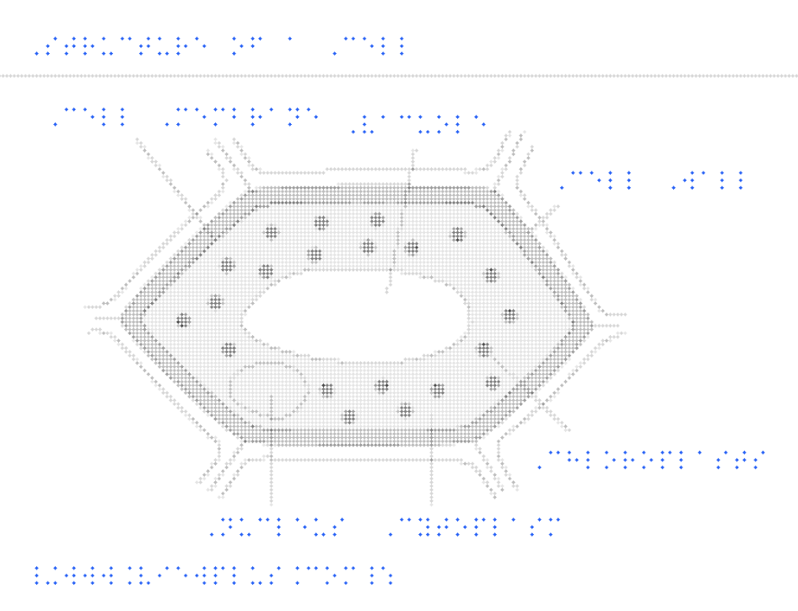
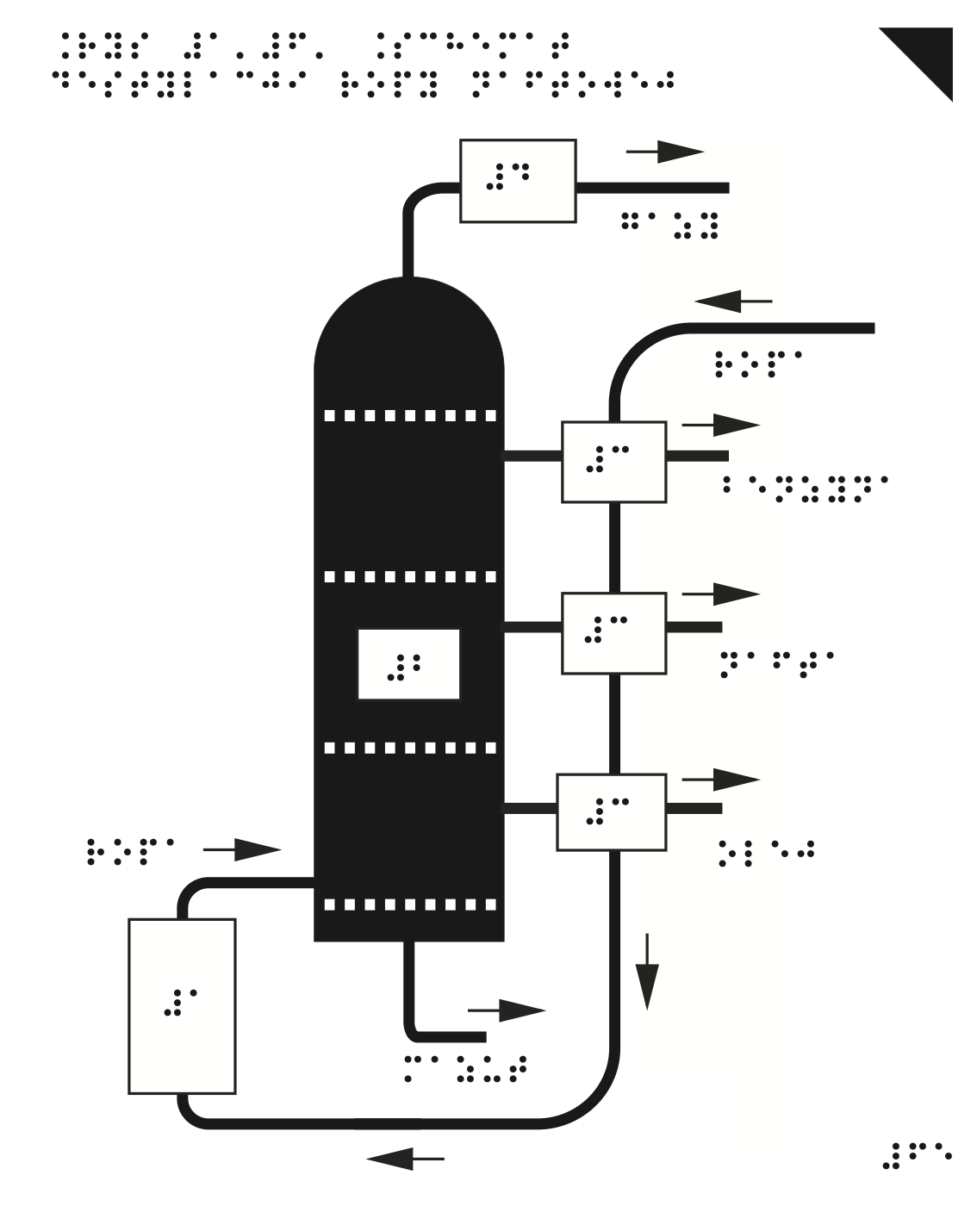
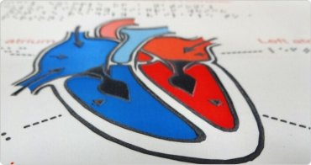
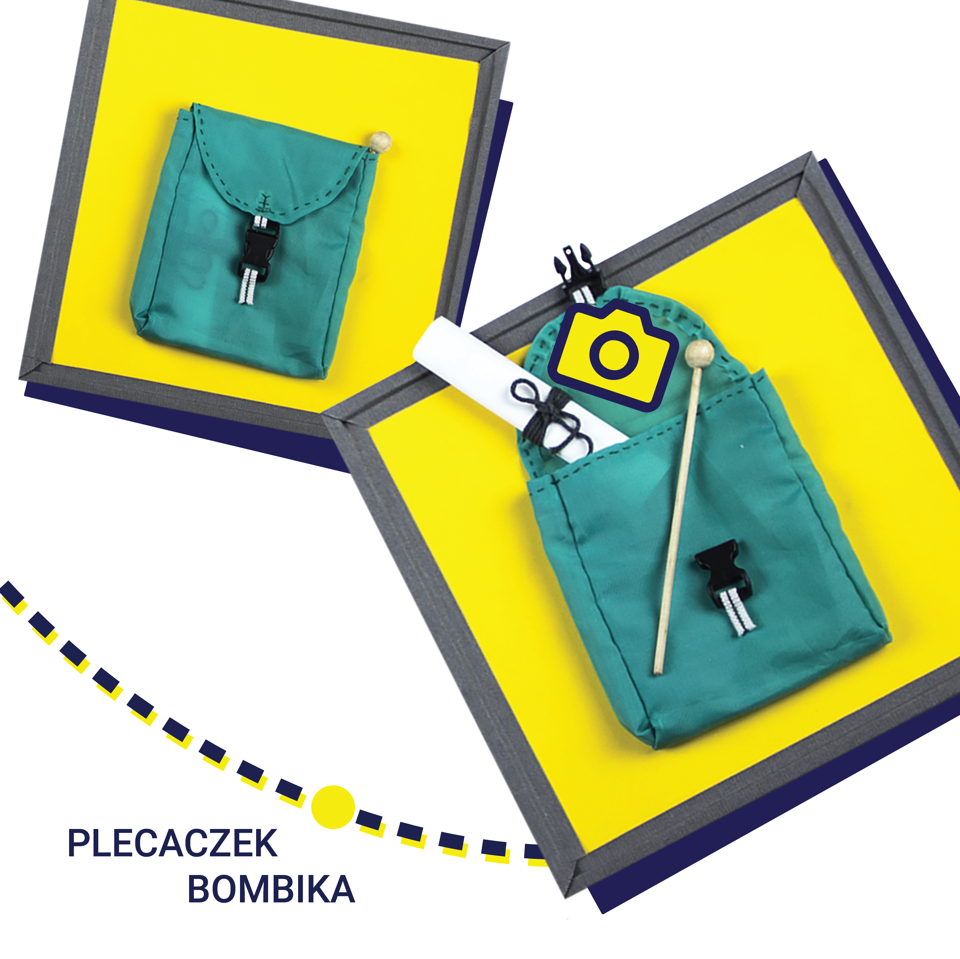
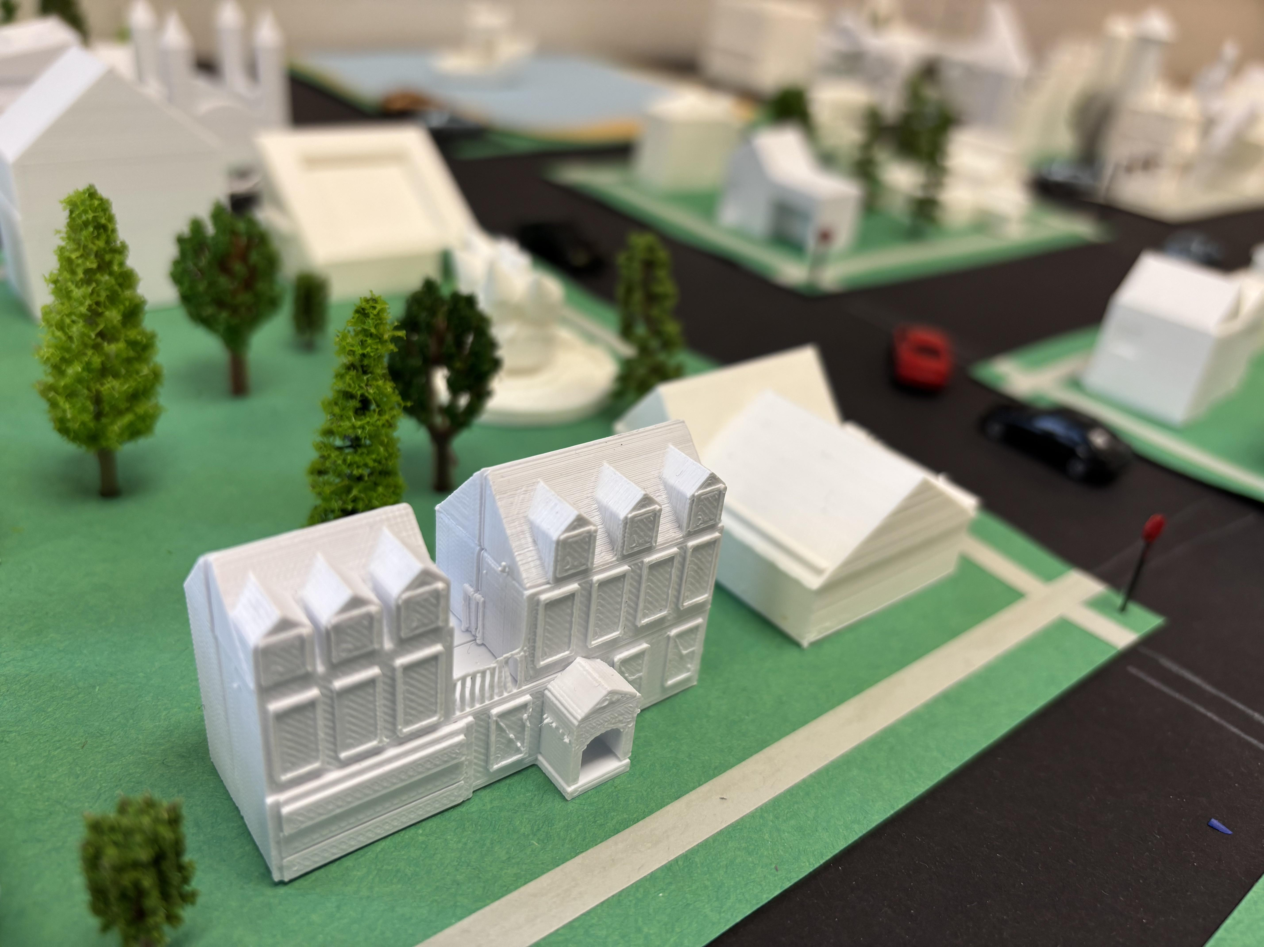
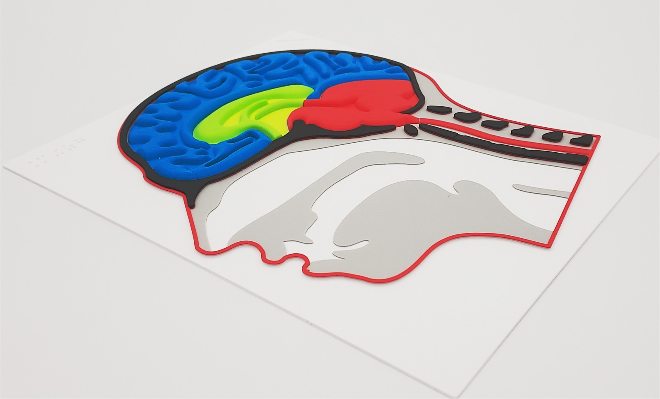
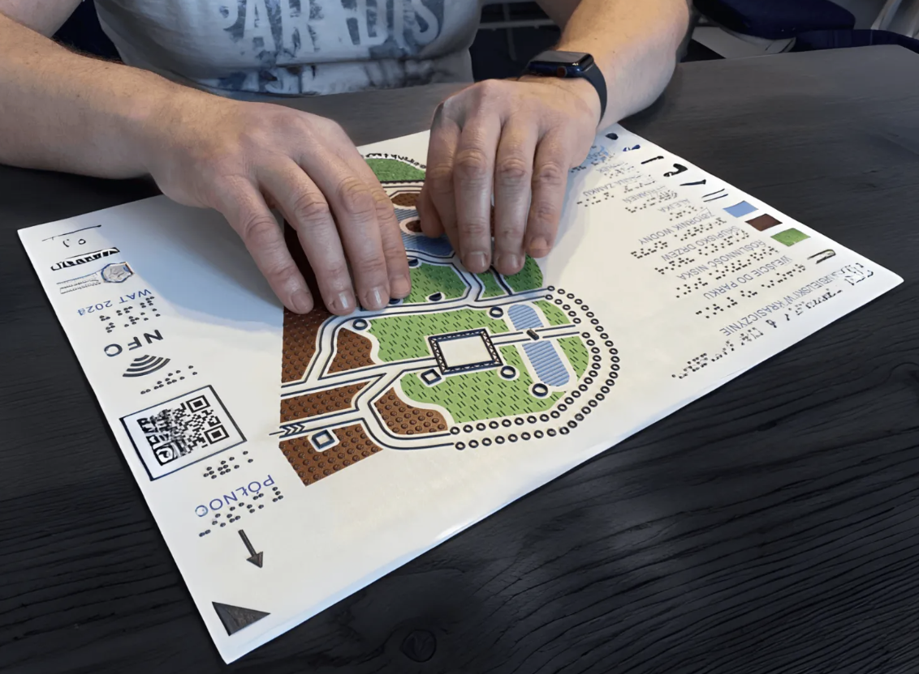
Production Techniques for Tactile Graphics
Swell paper
Thermoforming
Embossing
Thermorelief
Tactile collage
3D printing
Resin-based 3D
UV printing

Slide 8
Guidelines and standards for production
Recommended by the Ministry of National Education (2011):
Guidelines for creating and adapting graphics for students with blindness
https://pzn.org.pl/instrukcja-tworzenia-i-adaptowania-ilustracji-i-materialow-tyflograficznych-dla-uczniow-niewidomych-opracowana-przez-zespol-tyflopedagogow-ze-specjalnych-osrodkow-szkolno-wychowawczych-w-polsce-bydg/
Instructions for creating and adapting illustrations and tactile graphics for students with blindness
https://pzn.org.pl/zasady-tworzenia-i-adaptowania-grafiki-dla-uczniow-niewidomych-opracowane-przez-nauczycieli-specjalnych-osrodkow-szkolno-wychowawczych-dla-niewidomych-i-slabo-widzacych-w-polsce-bydgoszcz-laski-lo/
Principles for adapting educational materials into Braille
https://pzn.org.pl/zasady-adaptacji-materialow-dydaktycznych-do-wersji-brajlowskiej-pawel-wdowik-uniwersytet-warszawski-biuro-ds-osob-niepelnosprawnych-warszawa-2011/
Principles for adapting educational materials for people with visual impairment
https://pzn.org.pl/zasady-adaptacji-materialow-dydaktycznych-do-potrzeb-osob-slabowidzacych-pod-redakcja-donaty-konczyk-biuro-ds-osob-niepelnosprawnych-uniwersytetu-warszawskiego-warszawa-2011/
Standards for creating and adapting maps and atlases
https://pzn.org.pl/standardy-tworzenia-oraz-adaptowania-map-i-atlasow/
Warsaw University
Guidelines for Creating Maps and 3D Models and for the Use of 3D Printing to Support People with Blindness. Standards for Creating Tactile Plans and 3D Models for Students of the University of Warsaw.
https://cewis.uw.edu.pl/wytyczne-do-tworzenia-map-i-modeli-3d/#:~:text=Wytyczne%20do%C2%A0tworzenia%20map%20i%C2%A0modeli%203D%2C%20plik%20w%C2%A0formacie%20PDF%20%5B9%20MB%5D

Slide 9
Tactile Graphics Adaptors in Poland
Professional background
There is no formally recognised profession of tactile graphics adaptor in Poland.
Tactile graphics are produced by staff working in schools and educational centres for blind students, university accessibility and adaptation centres, and commercial companies.
Education and qualifications
Special education teachers, particularly specialists in education for blind and visually impaired students.
Professionals from other fields, including graphic designers and engineers.

Slide 10
Decision in adapting an image
School Environment
Teacher identifies the student’s needs and communicates them to the adaptor.
The teacher and adaptor discuss the most appropriate form of adaptation
Other Settings
Adaptation is carried out in response to individual requests.
The adaptor works directly with the client, providing expert advice and consultation to determine the most suitable solution.

Slide 11
Summary
In Poland, there is no single institution that people can contact to request tactile graphics. Custom-made tactile graphics are generally produced at the requester's own expense.
Most tactile graphics available in open-access repositories support education in STEM subjects, particularly mathematics, geometry, physics, and biology. Maps and plans, including geographical and historical maps, are also widely available.
There is no formalized cooperation between institutions.
Tactile graphics are generally not accompanied by instructions on how to explore or interpret them. However, Poland has a well-developed methodology for teaching students to read and interpret tactile graphics.

Slide 12
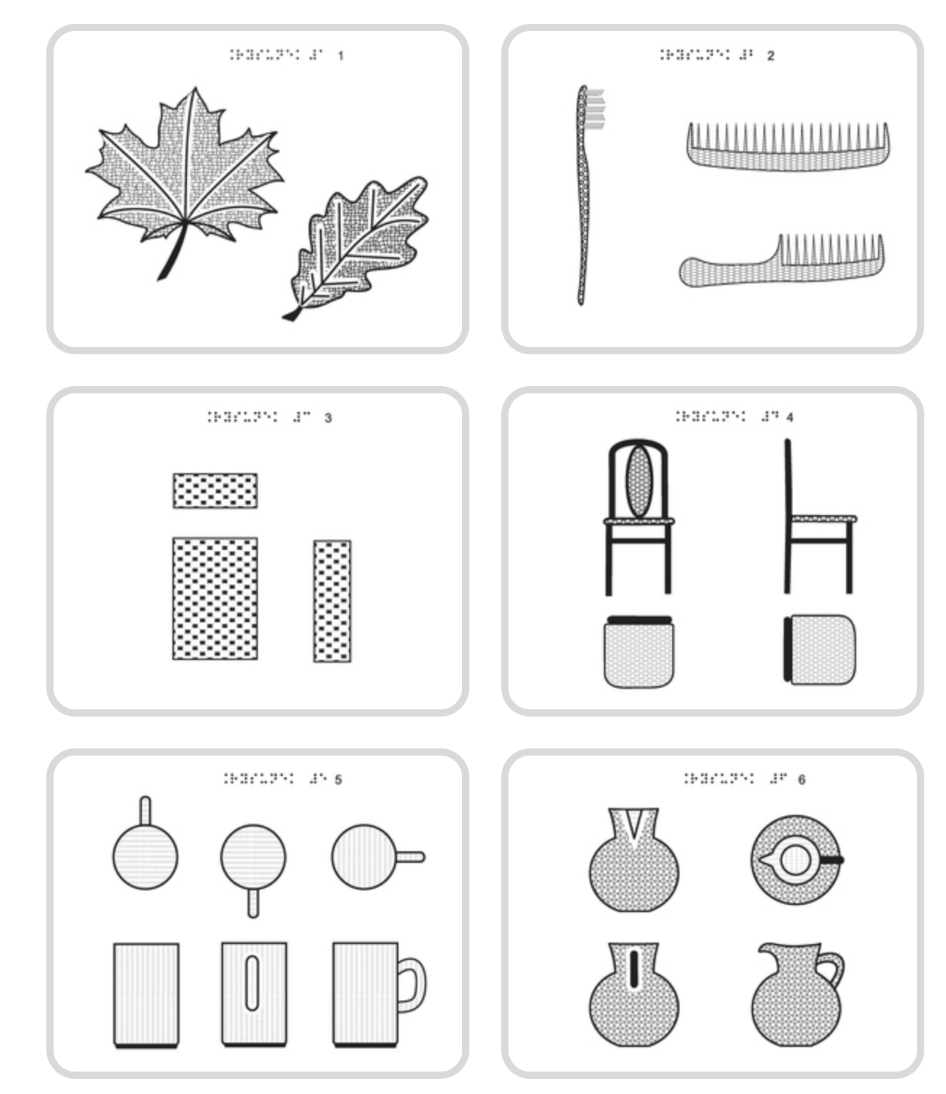
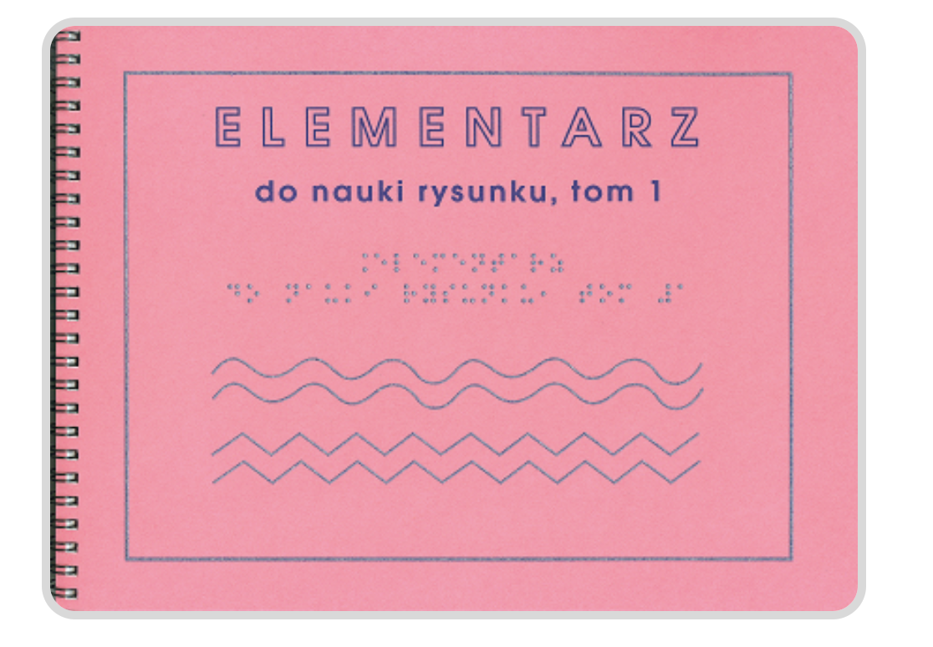
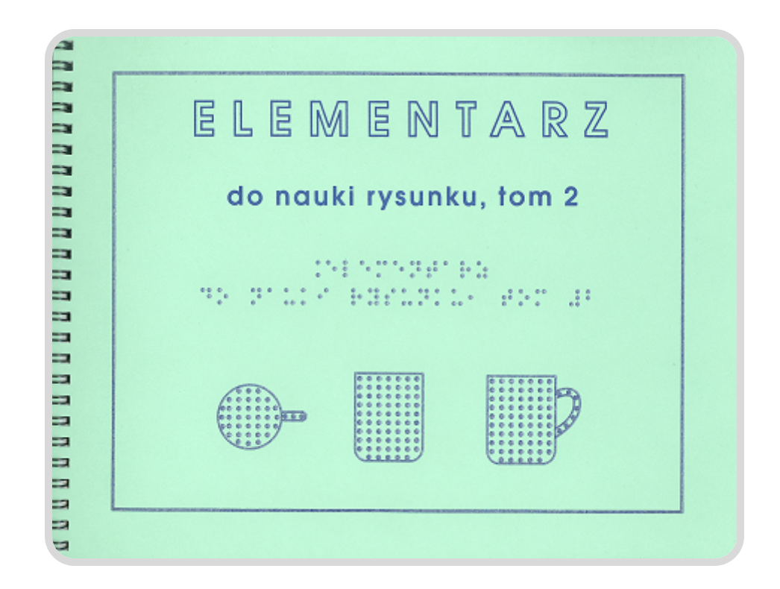
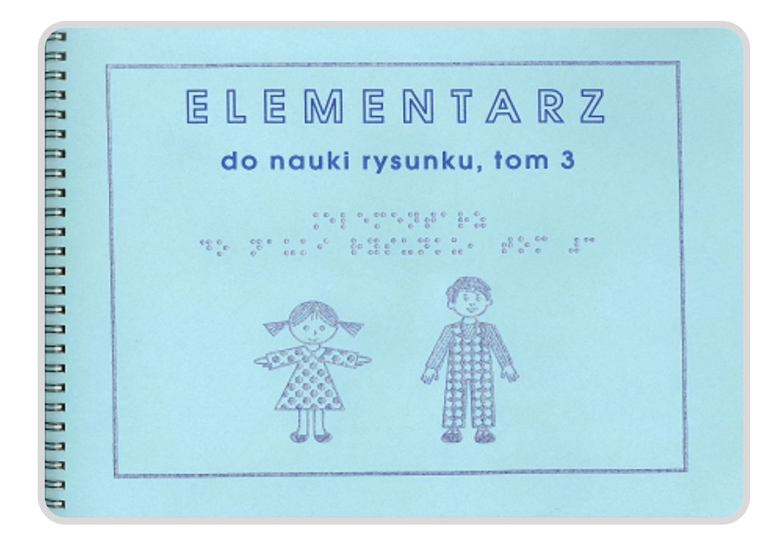
Primer for Learning to Draw
Benita Hadamik, Elżbieta Więckowska, Róża Czacka Special Educational Centre for Children with Blindness

Slide 13
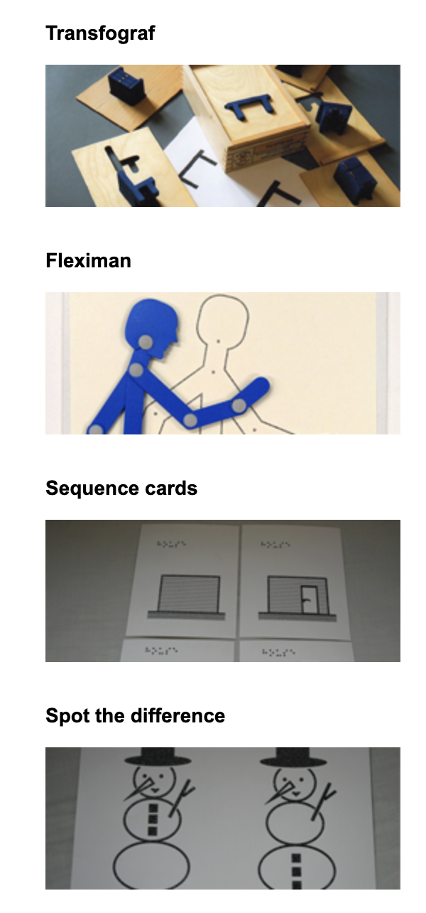
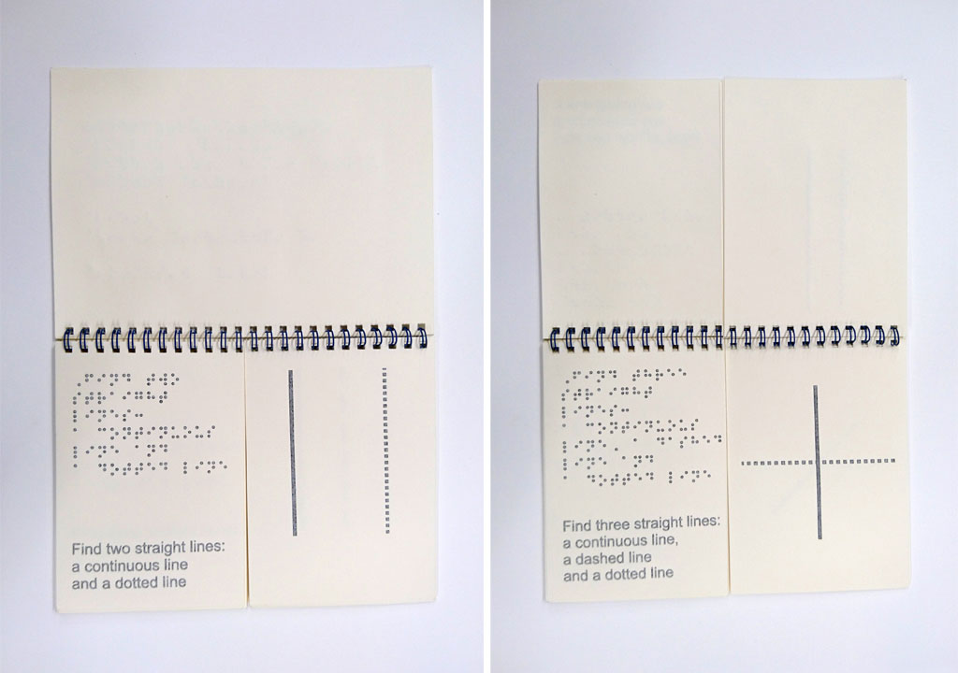
Hungry Fingers
Hungry Fingers is a one-man company specializing in designing and producing educational tools for young learners with a visual impairment. The tools are designed to help totally blind children understand difficult concepts based on visual experience, and on spatial relations needed for reading tactile graphics.
Prof. Bogusław Marek
https://www.hungryfingers.com/

Slide 14
Strengths vs. Weaknesses
School textbooks and tactile graphics
Repository of tactile graphics
Existing standards and guidelines
Teaching methodologies
Initiatives by non-governmental organisations (NGOs)
Growing interest in tactile graphics, particularly in testing new production methods, and a substantial amount of ongoing research.
Lack of one centralized repository
Lack of database of tactile graphics suitable for different production techniques
Insufficient attention to tactile graphics education in mainstream schools

Slide 15

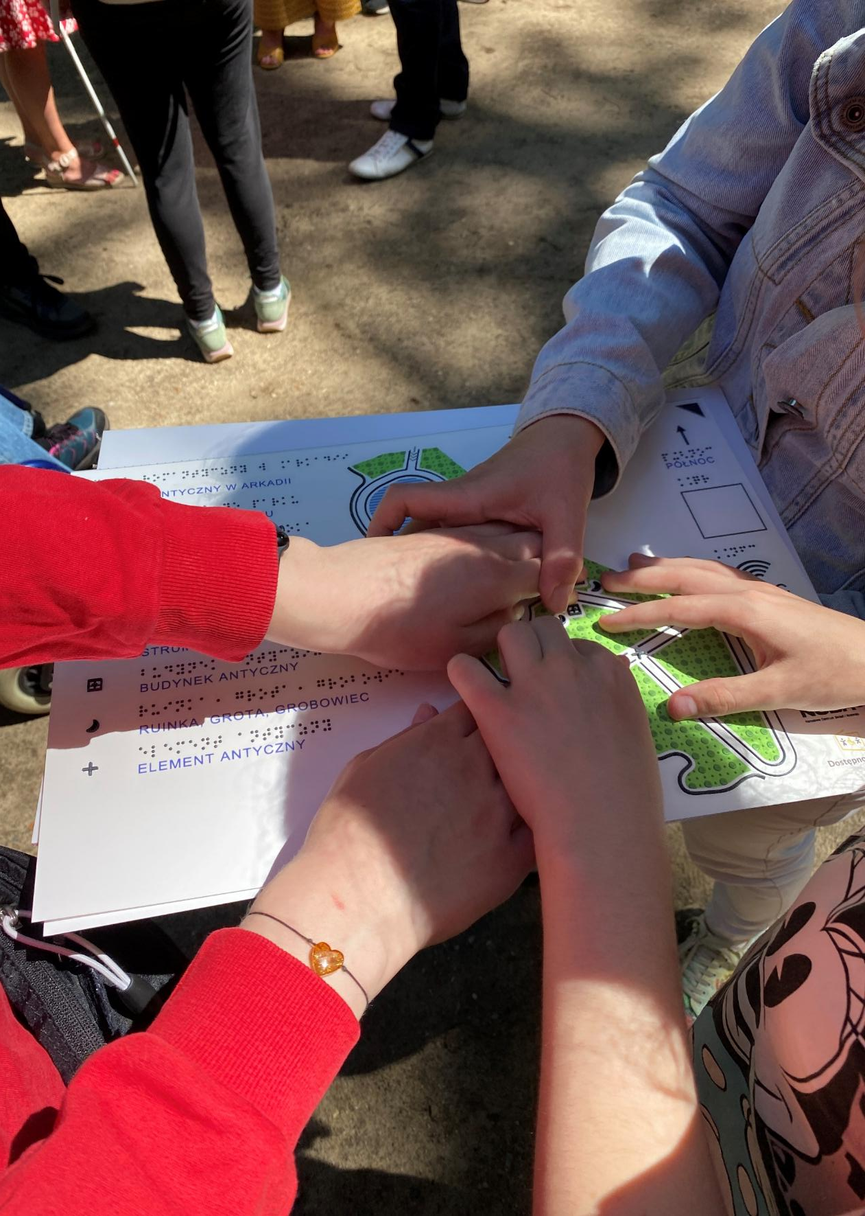


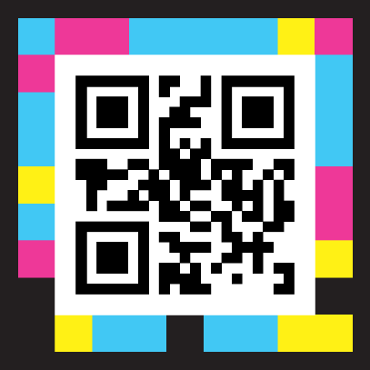


International platform of tactile graphics knowledge exchange
Website
https://t-rep.wat.edu.pl
„International platform of tactile graphics knowledge exchange” (2024-2027), the government-funded project financed by The Ministry of Science and Higher Education as part of the „Science for the Society II” programme (Poland)

Slide 16
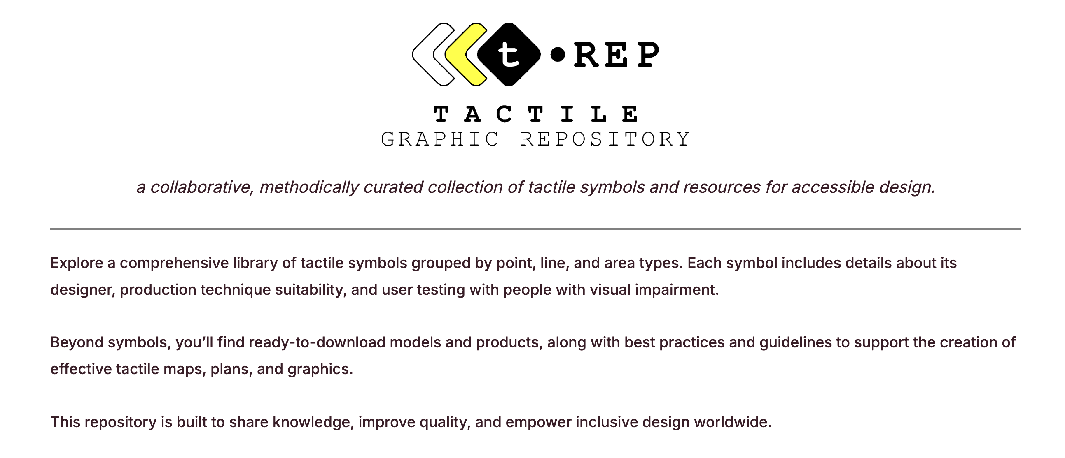
https://t-rep.wat.edu.pl/

Slide 17
THANK YOU FOR YOUR ATTENTION
e.smiechowska@uksw.edu.pl

